Slide 1
GEOG788P Final Project Presentation
Natalie Memarsadeghi

Slide 2
Goals
Calculate runoff volume during a rainfall event in upstate New York
Create a time lapse visualization displaying runoff volume

Slide 3
Background: Why is flood mapping important?
Identify high risk areas and evacuation needs
Assess at risk infrastructure and economic impacts of flooding
Natural stormwater management
Determining insurance rates and premiums for homeowners

Slide 4
Study Site and Temporal Scale
Site: Oatka Creek at Warsaw NY (drainage basin area = 39.5 square miles)
Water type: Stream
Time Period: 12pm October 3rd- 12am 5th, 2021
Cumulative Precipitation: Approximately 1.4 inches

Slide 5
Methods
Obtain data
Calculate runoff volume
Create time lapse visualization

Slide 6
Data Sources
Discharge and precipitation provided by USGS Water Watch in 15 minute intervals at rain gauge
NAIP imagery for basemap
Google Earth to digitize river

Slide 7
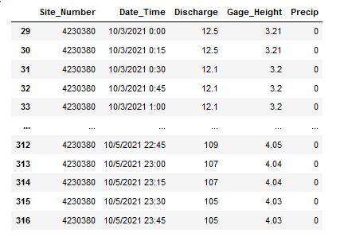
Storm Data
Notes:
This starts at midnight, storm starts at noon

Slide 8
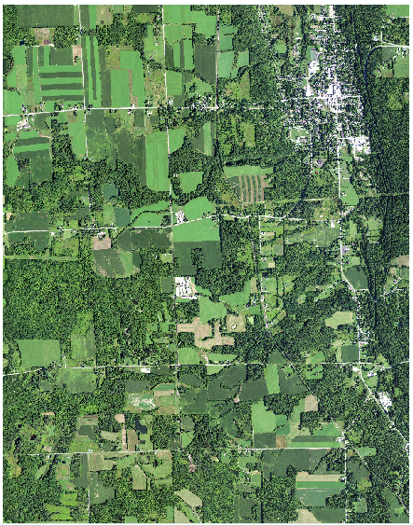
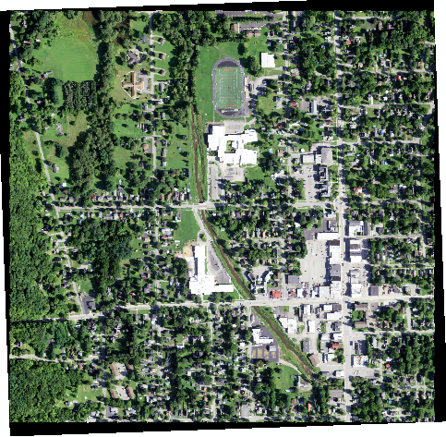
NAIP

Slide 9
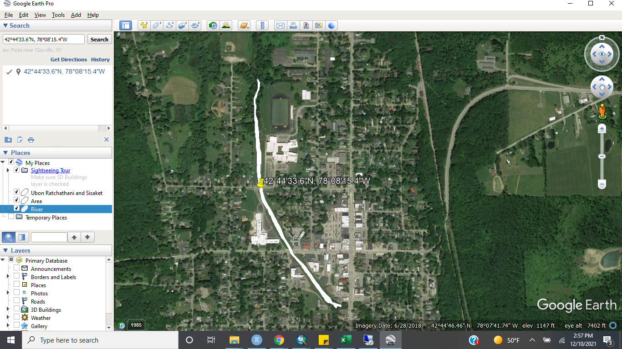

Slide 10
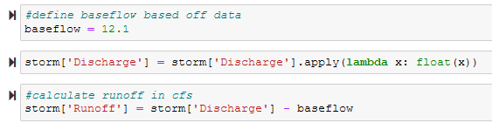

Calculations
Runoff volume (cf/ 15 minute interval) = (baseflow - current discharge)(60)(15)
Sum every four rows to get hourly runoff volume

Slide 11
Visualization
Digitize river
Join csv of runoff calculations and river shapefile
Loop to create individual scenes
Compile in gif

Slide 12
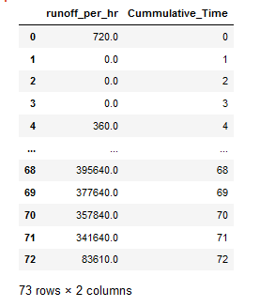
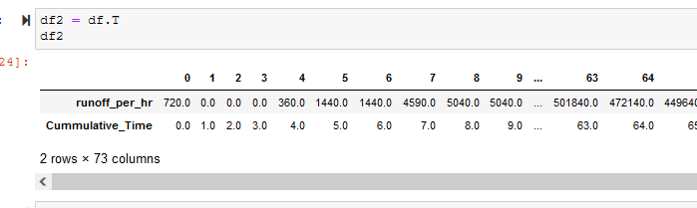

Slide 13
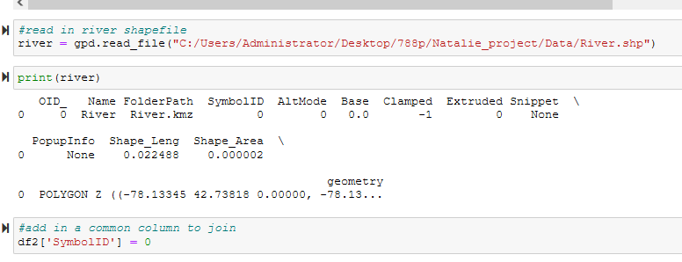

Slide 14
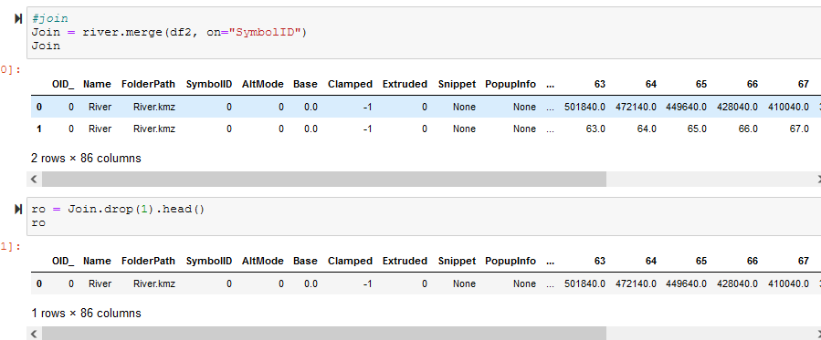

Slide 15
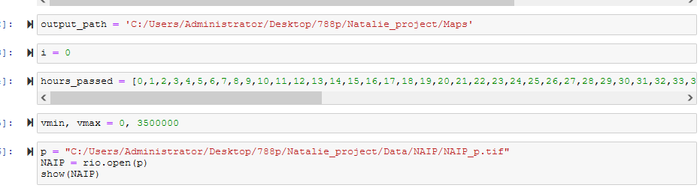

Slide 16
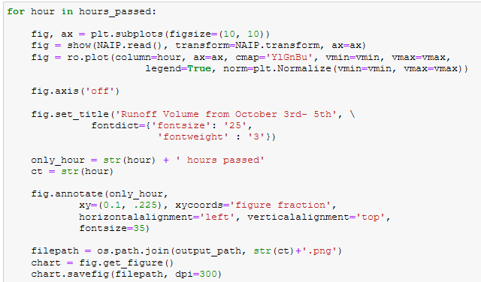

Slide 17
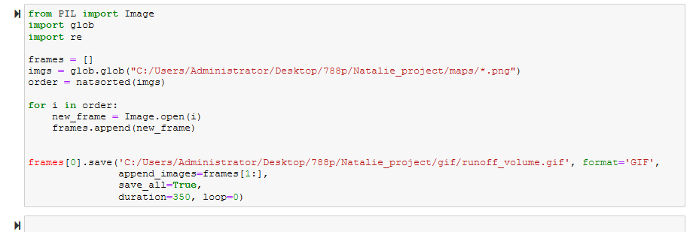

Slide 18
Final Result
We can see peak runoff volume at 43 hours since the start of the storm
The delay in runoff volume can be accounted for by the lag time of runoff
The lag time is the delay between the maximum rainfall amount and the peak discharge
Peak Runoff Volume: 43 hours after the storm starts
Maximum Rainfall: 16 hours after the start of the storm

Slide 19
Challenges and Adaptations
Limitations
Altered goals slightly because could not include extent
Because data comes from a single rain gauge, to calculate extent all the way down the river is challenging
Gif images not playing in order
Solved with nat sort
Spatial limitation because of gauge
Digitizing river not 100% accurate, but for visualization purposes
Large range of data values (0 - 3,500,000 cf)

